Slide 1
COMPUTER GRAPHICS
HAND-TRACKING USING OPENCV

Slide 2
ABSTRACT
Hand detection is a crucial component in various computer vision applications, including gesture recognition, human-computer interaction, and augmented reality. This paper presents a method for real-time hand detection using OpenCV, an open-source computer vision and machine learning software library. The proposed approach leverages color-based segmentation, contour detection, and convex hull techniques to accurately identify and track hand regions in live video streams. Initially, the system captures video frames and converts them to the HSV color space to improve robustness against lighting variations. Skin color segmentation is then performed to isolate potential hand regions. Contours of the segmented regions are extracted, and the largest contour, corresponding to the hand, is identified.

Slide 3
INTRODUCTION
In recent years, hand detection has emerged as a pivotal area in computer vision, driving innovations across various domains such as gesture recognition, human-computer interaction, sign language interpretation, and augmented reality. The ability to detect and interpret hand movements in real time offers a more intuitive and natural means of interacting with digital systems, paving the way for more immersive and user-friendly applications.
This project explores the implementation of a robust and efficient hand detection system using OpenCV, an open-source computer vision and machine learning library widely recognized for its versatility and ease of use. The proposed system is designed to accurately identify and track hand regions in live video streams, leveraging OpenCV’s powerful image processing capabilities.

Slide 4
LITERATURE REVIEW
a. Hand detection is a well-explored domain within computer vision, garnering extensive research due to its applications in gesture recognition, human-computer interaction (HCI), virtual reality (VR), and augmented reality (AR). Various approaches have been proposed over the years, ranging from traditional image processing techniques to modern deep learning methods.
b. With the advent of machine learning, hand detection saw significant advancements. Viola and Jones (2001) introduced a robust object detection framework using Haar-like features and AdaBoost classifiers. This method was later adapted for hand detection, enabling real-time performance with high accuracy. However, the reliance on handcrafted features limited its generalization capability.
c. Hand pose estimation has further enhanced hand detection by predicting key points on the hand. Simon et al. (2017) introduced a multi-view approach using CNNs to estimate 3D hand poses, significantly improving gesture recognition accuracy.

Slide 5
PROBLEM STATEMENT
Develop a Color-Based Segmentation Technique: Implement a method to segment hand regions based on skin color in the HSV color space, improving robustness against lighting variations.
Contour Detection and Analysis: Utilize contour detection to extract hand outlines and identify the largest contour corresponding to the hand.
Feature Extraction and Gesture Recognition: Compute the convex hull of the hand contour to detect fingers and recognize hand gestures.
Real-Time Performance: Ensure the system operates in real-time, suitable for integration into various applications such as gesture recognition, human-computer interaction, and augmented reality.
User-Friendly Implementation: Provide an easy-to-use and extendable codebase that can be customized for specific use cases.

Slide 6
OBJECTIVES
Real-time Hand Detection: Develop a system that can detect and track hands in real-time using a video feed from a camera.
Accuracy: Achieve high accuracy in identifying and distinguishing hands from other objects or background noise.
Robustness: Ensure the system performs well under various conditions, such as different lighting, backgrounds, and hand orientations.
Gesture Recognition: In some cases, extend the project to recognize specific hand gestures or movements for applications like sign language recognition or human-computer interaction.
Performance: Optimize the system for speed and efficiency to ensure smooth operation without significant delays or computational overhead.

Slide 7
PROPOSED SOLUTION
i. Setup and Preprocessing
Install Dependencies: Ensure you have OpenCV installed, along with any other necessary libraries (e.g., NumPy).
Capture Video: Use a camera to capture real-time video feed.
Preprocessing: Convert video frames to grayscale to simplify processing and reduce computational load.
ii. Hand Detection
Background Subtraction: Use techniques like background subtraction or image thresholding to isolate the hand from the background.
Contour Detection: Apply contour detection to identify and segment the hand from other objects. The contours can be used to find the hand's outline.
Region of Interest (ROI): Define and extract the region where the hand is most likely to be detected.

Slide 8
iii. Post-processing
Filtering and Smoothing: Apply filters to smooth out the detected hand’s movements and reduce noise.
Gesture Recognition : Implement algorithms to recognize specific hand gestures or movements, using techniques such as template matching or machine learning models.
iv. Visualization and Feedback
Display Results: Draw bounding boxes or contours around the detected hand and display the results in real-time.
Provide Feedback: Optionally, provide feedback based on the detected hand position or gestures (e.g., control actions, notifications).
v. Optimization and Testing
Performance Tuning: Optimize the solution for real-time performance, minimizing latency and computational load.
Testing: Test the system under various conditions (lighting, backgrounds, hand sizes) to ensure robustness and accuracy.

Slide 9
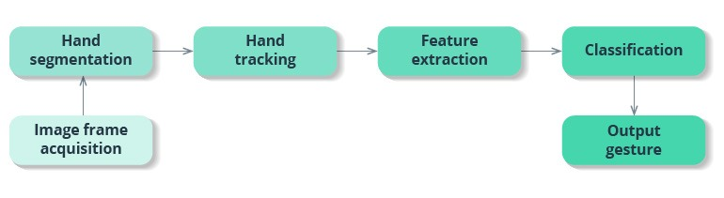
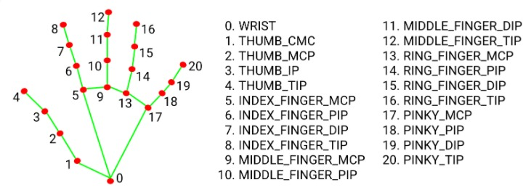
FIG : Process of Hand Tracking
FIG : Parts in hand that can be detected.

Slide 10
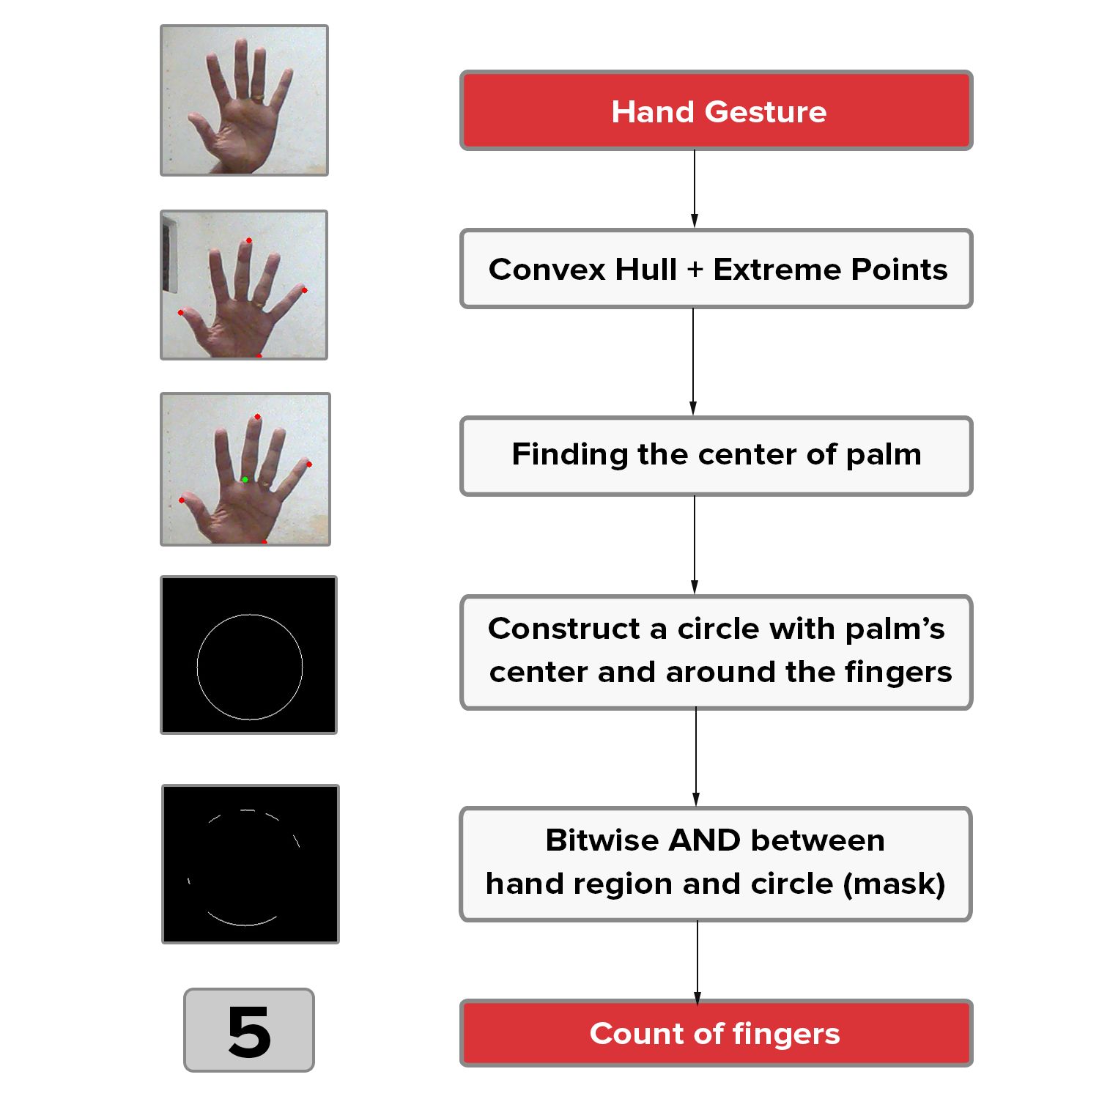
FIG : Steps involved in the process of hand detection.

Slide 11
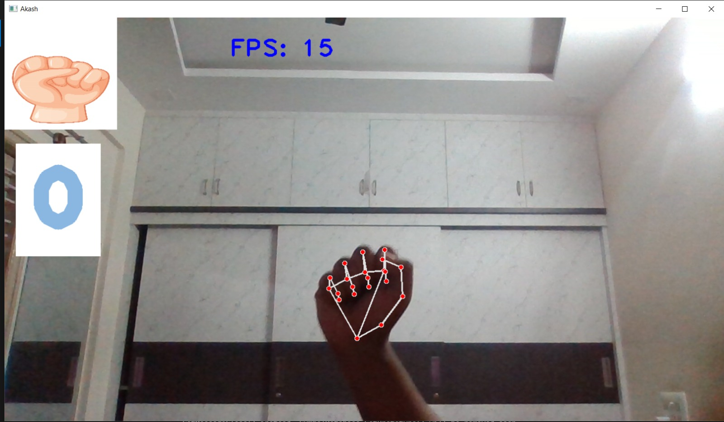
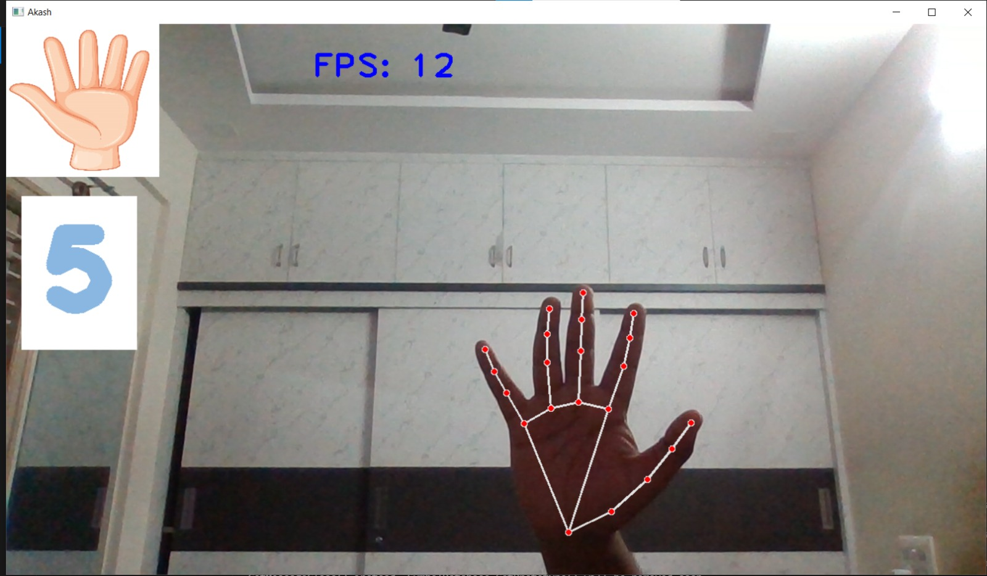
OUTPUT

Slide 12
POSSIBLE OUTCOMES
i. Basic Hand Detection
Hand Localization: Successfully detect and highlight the presence of hands in a video feed, marking them with bounding boxes or contours.
Hand Count: Determine the number of hands present in the scene.
ii. Hand Tracking
Real-time Tracking: Continuously track the position and movement of hands across consecutive frames.
Path Visualization: Visualize the movement path of the hand, useful for gesture analysis or interaction tracking.
iii. Gesture Recognition
Simple Gestures: Recognize basic hand gestures such as open hand, closed fist, thumbs up, or specific finger positions.

Slide 13
Complex Gestures: Identify more complex gestures or sequences of gestures, potentially using machine learning models.
iv. Sign Language Recognition
Alphabet Recognition: Recognize static hand gestures corresponding to sign language alphabets.
Word or Phrase Recognition: Identify dynamic gestures representing words or phrases in sign language.
v. Interaction with Applications
Human-Computer Interaction: Implement hand detection for controlling applications, such as virtual buttons, sliders, or drag-and-drop interfaces.
Gaming: Use hand gestures for controlling game actions or navigating virtual environments.

Slide 14
ADVANTAGES
Real-time Processing: With efficient algorithms, hand detection using OpenCV can process video frames in real-time, making it suitable for interactive applications.
Cost-Effective: OpenCV is an open-source library, so it’s cost-effective compared to proprietary software or hardware solutions.
Flexibility: OpenCV provides various tools and techniques that can be adapted for different hand detection needs and environments.
Scalability: The system can be scaled and modified to recognize different hand gestures or integrate with other technologies.
Community Support: OpenCV has a large user community and extensive documentation, which can aid in troubleshooting and development.

Slide 15
DISADVANTAGES
Sensitivity to Conditions: The performance can be affected by varying lighting conditions, background clutter, or hand sizes. Robustness might be a challenge.
Computational Load: Real-time processing, especially with high-resolution video, can be computationally intensive, requiring a powerful CPU/GPU.
Accuracy Limitations: Simple hand detection methods might struggle with complex gestures or hands in unusual positions. More advanced methods might be needed for higher accuracy.
Learning Curve: Developing an effective hand detection system requires a good understanding of computer vision concepts and experience with OpenCV.
Maintenance: Keeping the system updated and functional over time may require ongoing adjustments and optimizations as new challenges or technologies emerge.

Slide 16
CONCLUSION
In conclusion, a hand detection project using OpenCV represents a versatile and impactful venture that leverages computer vision technology to enable real-time hand recognition and interaction. By utilizing OpenCV's powerful libraries and tools, this project can achieve robust hand detection and tracking, facilitating applications ranging from simple user interface controls to complex gesture-based systems. Despite challenges related to varying environmental conditions and computational demands, the potential benefits in fields such as human-computer interaction, gaming, assistive technologies, and educational tools are substantial. With ongoing advancements and optimizations, this project holds promise for creating intuitive and innovative solutions that enhance user experiences and broaden the scope of interactive applications.

Slide 17
REFERENCES
https://github.com/Amar1510/Hand-Gesture-Recognition-Using-OpenCV-and-Python
https://www.youtube.com/watch?v=01sAkU_NvOY
https://github.com/nicknochnack/HandPose
https://www.youtube.com/watch?v=NwN3r3rVX9o

